Slide 1

Presentation Materials Created by Mimetics Inc.
Free use by anyone for non-commercial purposes
Copyrights, Trademarks and other Registered Marks the Property of their Owners

Slide 2
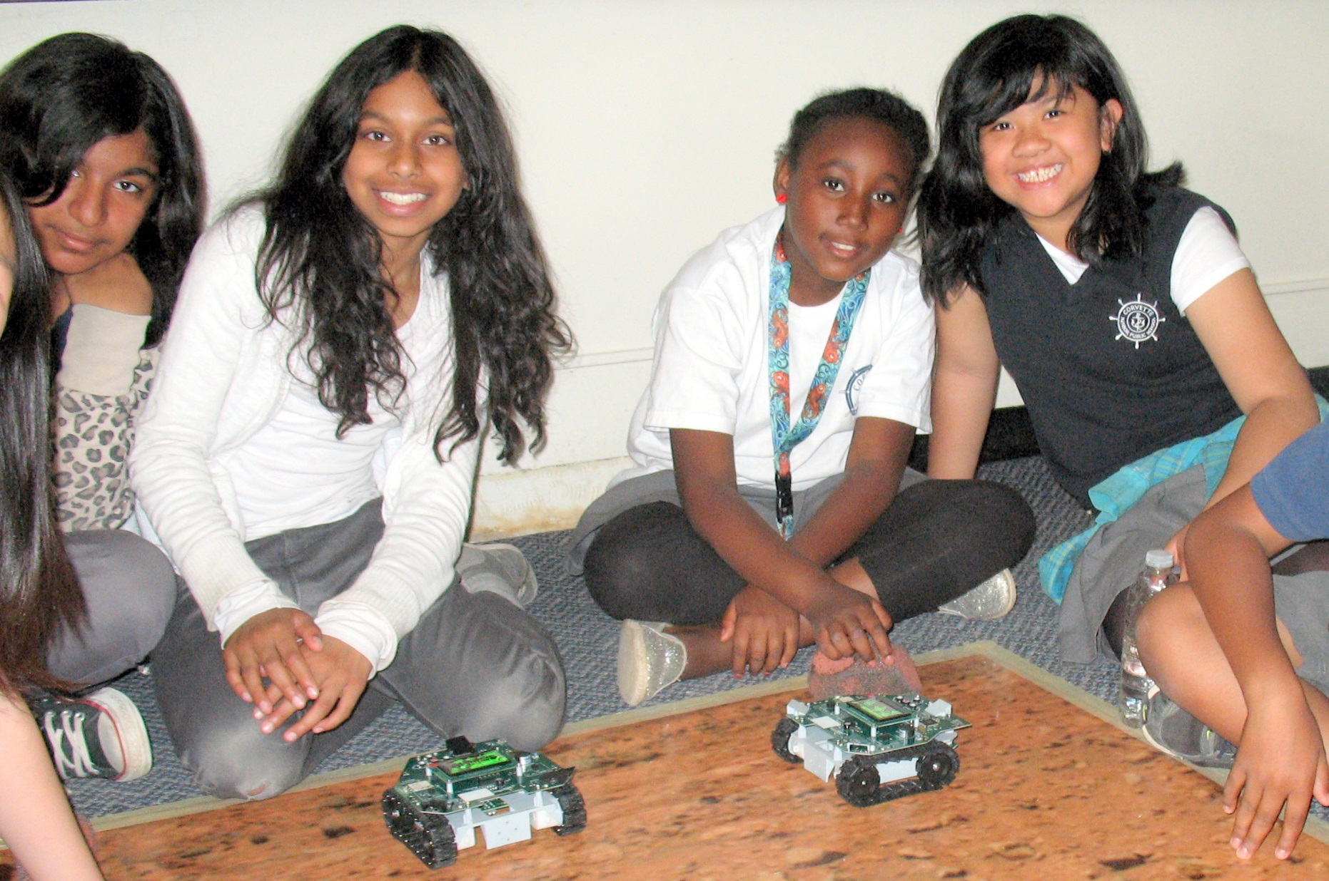
Introduction to Robotics and Programming with the Jade Robot
Notes:
We want to introduce the Jade Robot and it’s Tools in more detail along with our action plans for it.
It’s interesting, but it’s easy to criticize something when it’s done (especially when you have experience) – a *LOT* more difficult getting it right from the start. Also, preparing this presentation was a great way to review and think about what we should be doing.

Slide 3
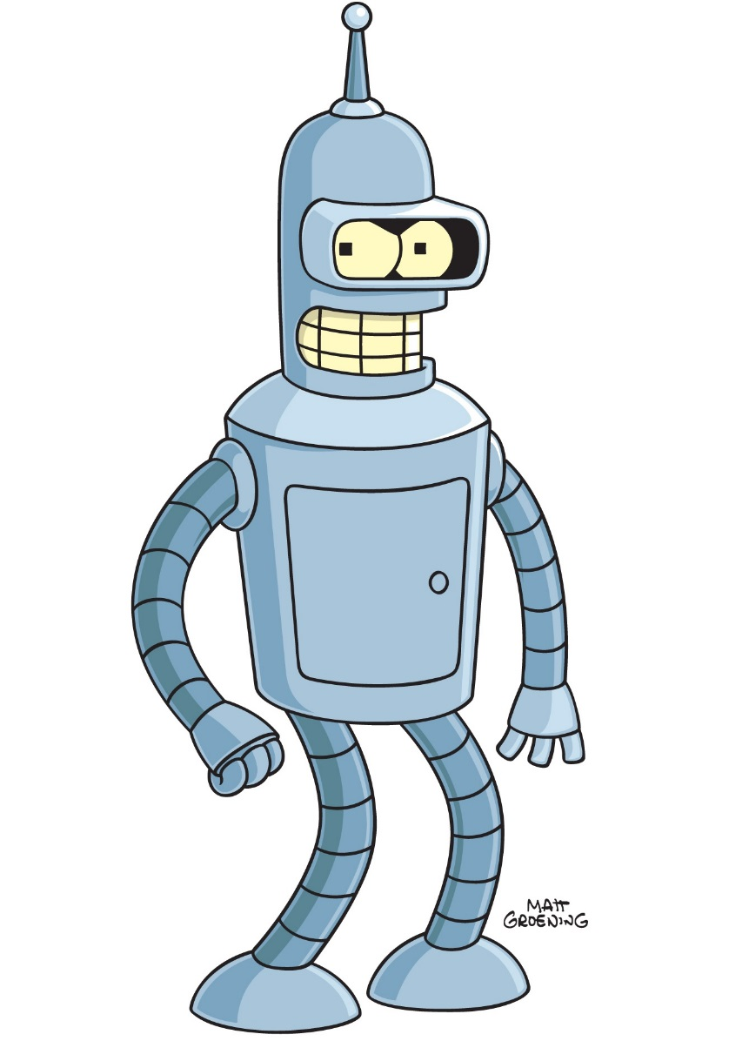
Objectives
What is a Robot?
What are the different types?
What is it Used for?
What do you want to do with one?
Learn to Program a Robot
Basic Movements
Responding to Inputs
Solving Problems
Learn about the Parts of a Robot
Movement & Output
Input (and Sensors)
Controller
Software
Create Your Own Programs
Designing the Program
Debugging
Evaluating the Solution
Notes:
Use the white boards to list the different robot types, uses & as what the kids want to use it for.
Note that Evaluating the Solution will be a competition.

Slide 4
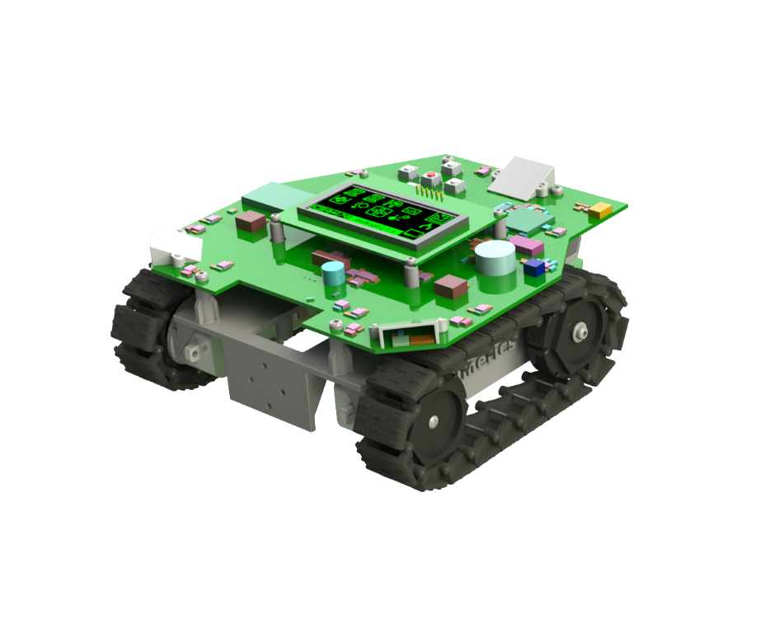
The Jade Robot
Camera
Interface
Navigation
Pad
Bluetooth
Interface
Two I²C
Expansion
Ports
OLED
Display
All Aspect
Object
Sensors
All Aspect
Light
Sensors
Speaker
DC Motors
Driving Tracks
Mounting
Plate
Spectrometer
and Line Sensors
On Bottom
Two Servo
Drivers

Slide 5
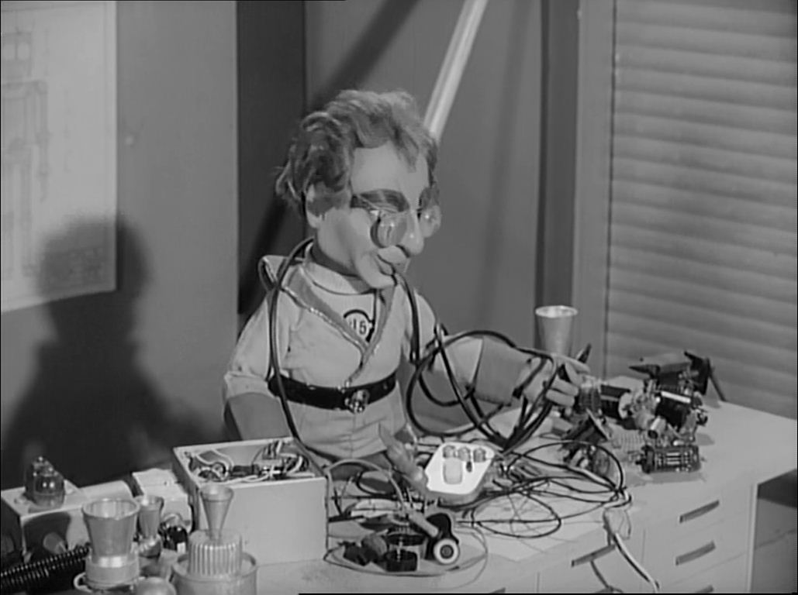
Rule One
Robots Run on the Floor
NO BROKEN ROBOTS!
Notes:
Can Demo Jade Scratch if people are interested. In doing this product I’ve had a few interesting discoveries – one was going with a simpler programming language actually has a *LOT* of value for an expert like myself.

Slide 6

Rule Two
We ALL Stay Together
Don’t Go Ahead Until Told
If You Have a Problem, Put Up Your Hand!
Notes:
Can Demo Jade Scratch if people are interested. In doing this product I’ve had a few interesting discoveries – one was going with a simpler programming language actually has a *LOT* of value for an expert like myself.

Slide 7
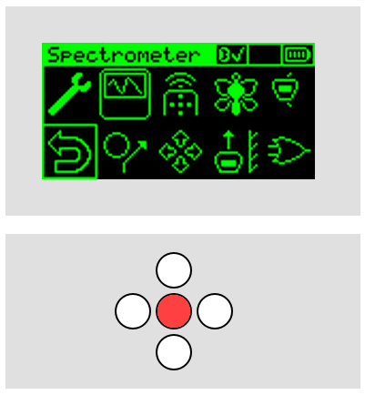
User Interface
“Tools” Menu
Basic Operations:
Press White “Down” Button to Wake Up
White Buttons to point to “Objects:
Programs
Controls
Red “Enter” Button Selects Object
End Program:
Go to “Return” Control (Bottom Left)
Press Red “Enter” Button
“Return”
Control
“Enter”
Button
Movement
(“Navigation”)
Buttons
“Wake Up”
Button
Notes:
Can Demo Jade Scratch if people are interested. In doing this product I’ve had a few interesting discoveries – one was going with a simpler programming language actually has a *LOT* of value for an expert like myself.

Slide 8
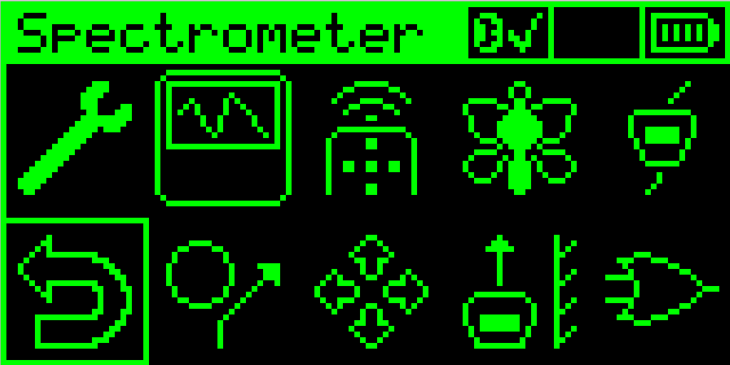
Experiment with Built in Programs
Remote Control
Light Seeking
Object Avoid
Wall Follow
Notes:
Show Off Different Activities they can start with

Slide 9
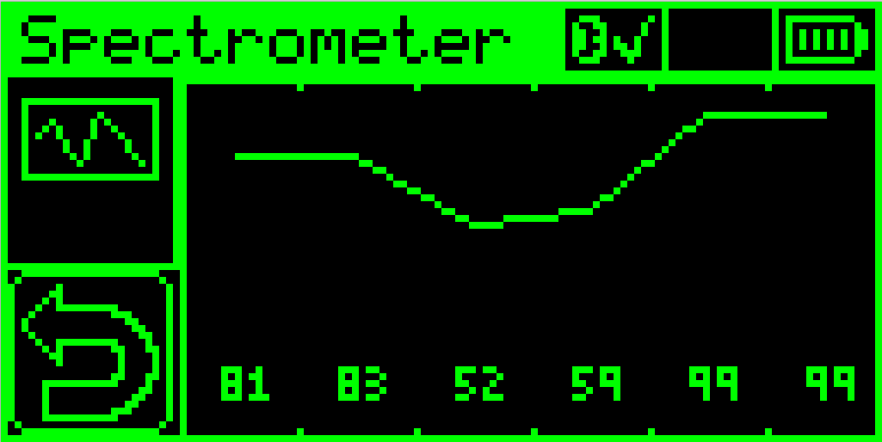
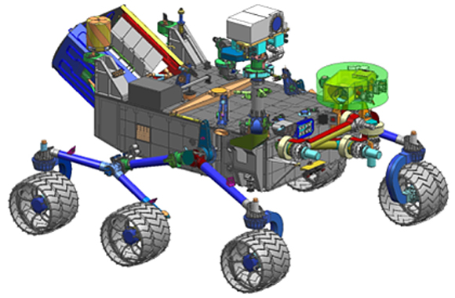
Reflectance Spectrometer
Place Robot on Object and Select “Spectrometer”
Compare Different Surfaces
Used on Space Craft
The Spectrometer Shines Different Wavelength (Colour) Light and Measures the Reflection
Different Materials Reflect Differently
Notes:
Show Off Different Activities they can start with

Slide 10
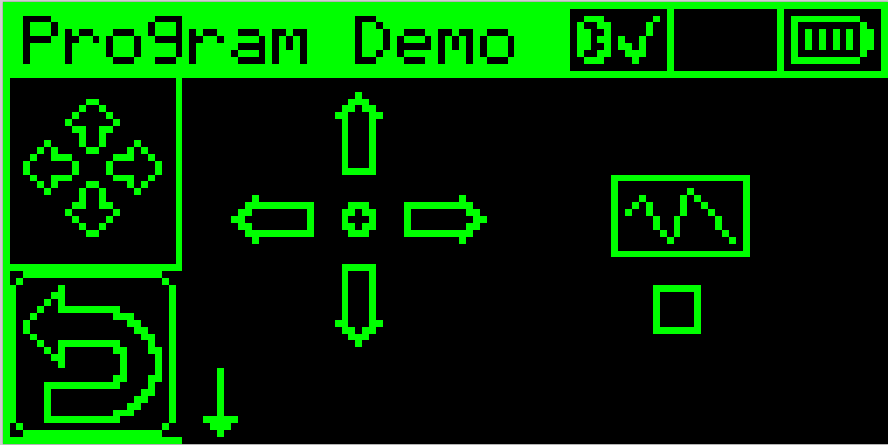
Simple Programming
Movement Selection
Execution Start
You can Create Your Own Program
Use the White (and Red) Buttons to Create a Program
Go to the Centre Control to Try the Program
Entered Program
Do Spectrometer
Reading at End
Notes:
Ask “What is a Program”?

Slide 11
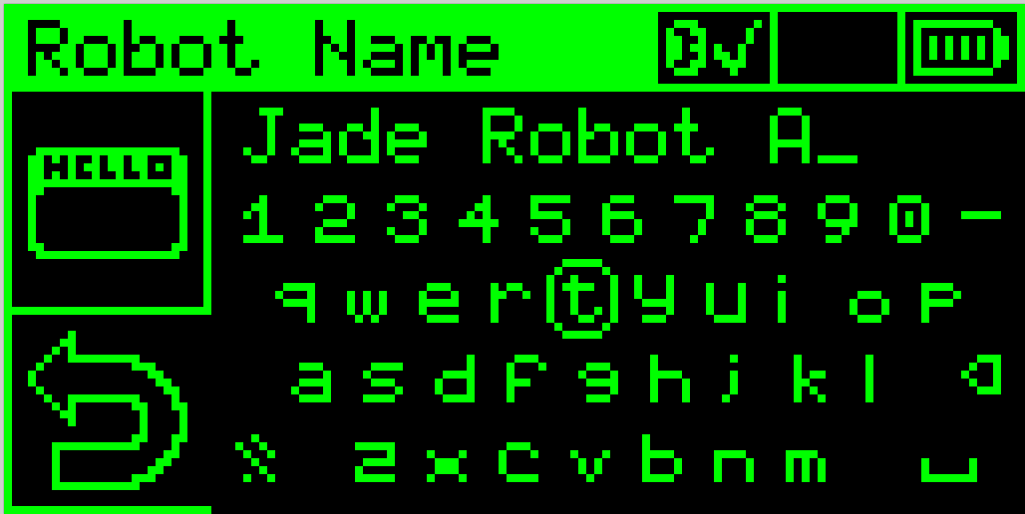
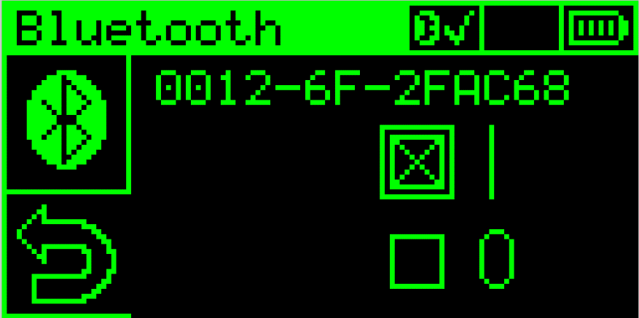
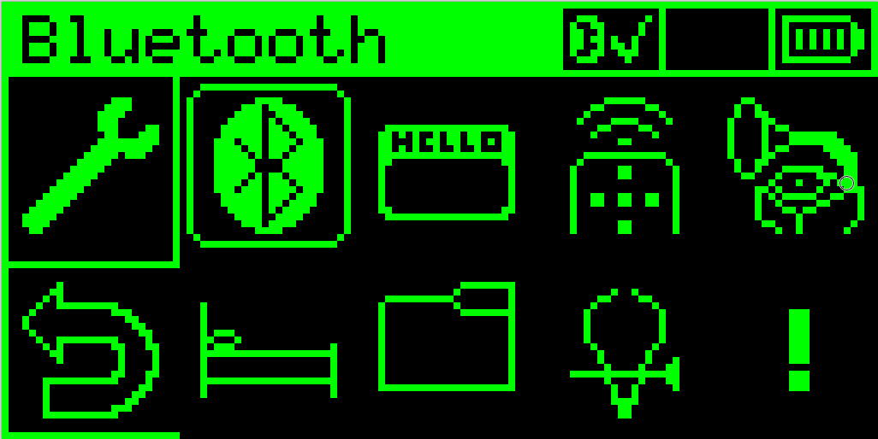
Turn on Bluetooth
Step 1: Goto “Tools”
Step 3: Enable Bluetooth & Return
Step 2: Goto “Bluetooth”
“Bluetooth” On
“Return” Control
Notes:
Can Demo Jade Scratch if people are interested. In doing this product I’ve had a few interesting discoveries – one was going with a simpler programming language actually has a *LOT* of value for an expert like myself.

Slide 12
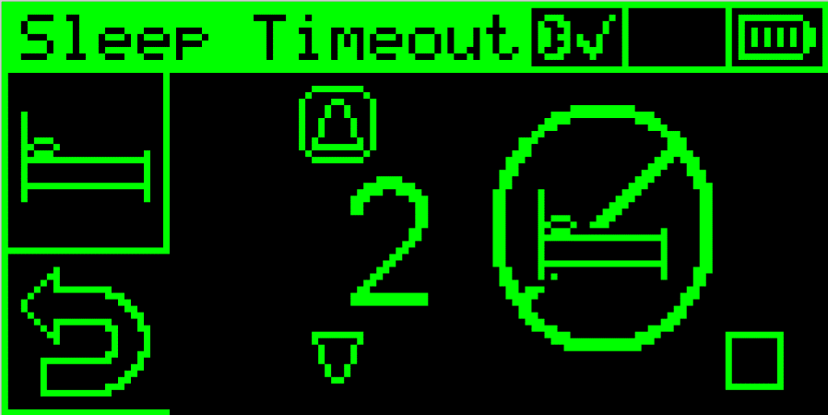
Disable Timeout
Step 1: Goto “Tools”
Step 3: Disable Timeout & Return
Step 2: Goto “Sleep Timeout”
Sleep Disabled On
“Return” Control
Notes:
Can Demo Jade Scratch if people are interested. In doing this product I’ve had a few interesting discoveries – one was going with a simpler programming language actually has a *LOT* of value for an expert like myself.

Slide 13
Set Robot Name
Step 1: Goto “Tools”
Step 3: Enter Name & “Return”
Step 2: Goto “Robot Name”
“Uppercase” Control
“Return” Control
NOTE: Everybody will See your Robot’s Name
& “R2D2” is Probably Taken
Notes:
Can Demo Jade Scratch if people are interested. In doing this product I’ve had a few interesting discoveries – one was going with a simpler programming language actually has a *LOT* of value for an expert like myself.

Slide 14
Pair Robot
 | WinXP | Win7 & Win8 | Mac
Step 1: Open Bluetooth Management | Right Click Bluetooth Icon and select “Add Bluetooth Device” | Open “Devices and Printers” | “System Preferences” ➔ “Bluetooth”
Step 2: Select Your Robot from Others | Use Wizard with “Device Ready” Checked | “Add a device” ➔ Select Jade Robot Name | Find Jade Robot Name & Click on “Pair”
Step 3: Enter “1234” if PIN is Requested | “Use Passkey Found in Documentation” | Probably Not Required | Probably Not Required
Step 4: Record the “com#” of the Jade Robot | “Show Bluetooth Device” ➔ “Com Ports” Tab & Find Outgoing Com Port for Device | Right Click Jade Robot Name in “Devices and Printers”, Select “Properties” ➔ “Hardware” | No Required. Mac Uses Jade Robot Name
Notes:
Can Demo Jade Scratch if people are interested. In doing this product I’ve had a few interesting discoveries – one was going with a simpler programming language actually has a *LOT* of value for an expert like myself.

Slide 15
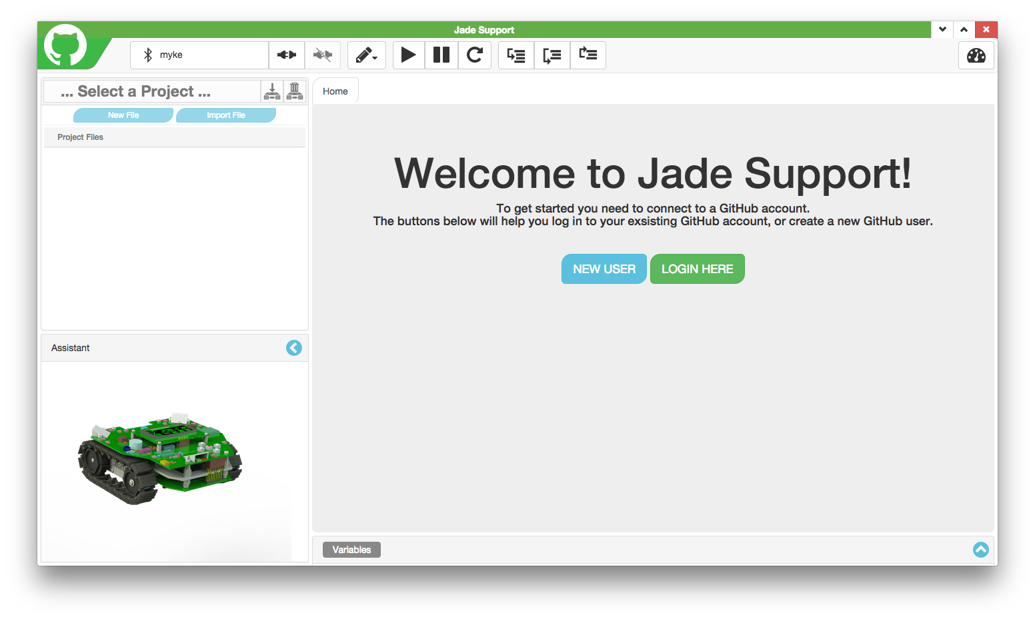
Jade Support
Click “New User” if don’t have GitHub
Click “Login Here” if have GitHub
Notes:
Can Demo Jade Scratch if people are interested. In doing this product I’ve had a few interesting discoveries – one was going with a simpler programming language actually has a *LOT* of value for an expert like myself.

Slide 16
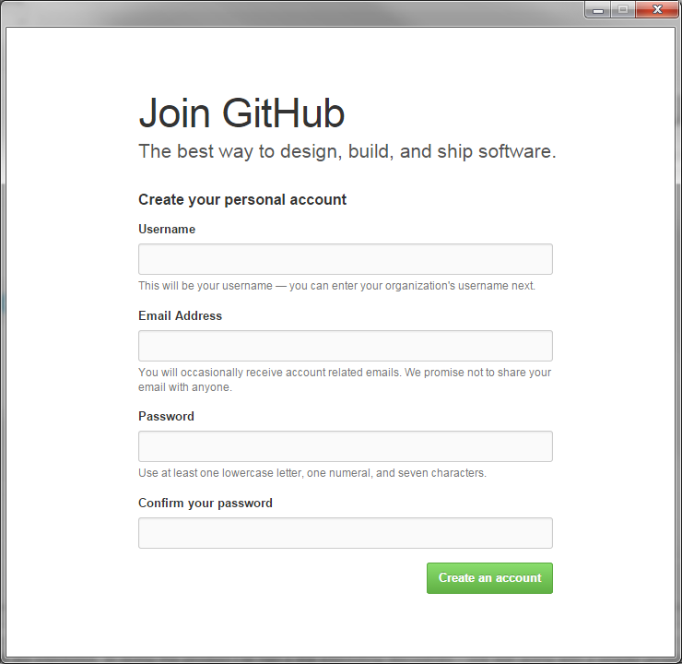
Joining GitHub
Enter Requested Information
GitHub is a Program Storage Service. Jade Robot projects will be stored here and accessible ANYWHERE.
You will not get Spam or have your Email shared with Spammers
Notes:
Can Demo Jade Scratch if people are interested. In doing this product I’ve had a few interesting discoveries – one was going with a simpler programming language actually has a *LOT* of value for an expert like myself.

Slide 17
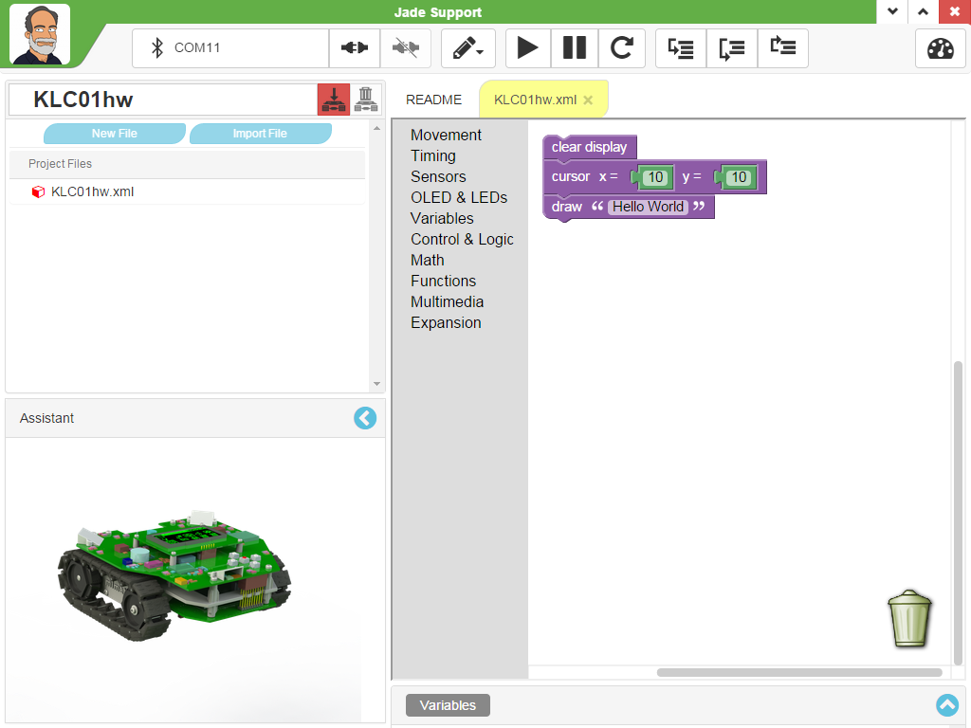
Jade Support
Execution Controls
Connection Controls
Project Selection
Project File List
Scratch Playground
Notes:
Can Demo Jade Scratch if people are interested. In doing this product I’ve had a few interesting discoveries – one was going with a simpler programming language actually has a *LOT* of value for an expert like myself.

Slide 18
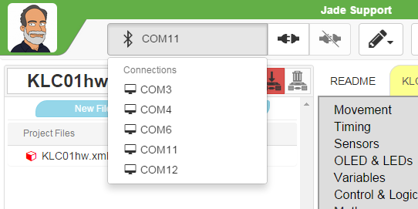
Connect Jade Robot
Connect Icon
Disconnect Icon
Selected Com Port
Available Com Ports
(Windows Only)
Connect Jade Robot Now
Notes:
Can Demo Jade Scratch if people are interested. In doing this product I’ve had a few interesting discoveries – one was going with a simpler programming language actually has a *LOT* of value for an expert like myself.

Slide 19
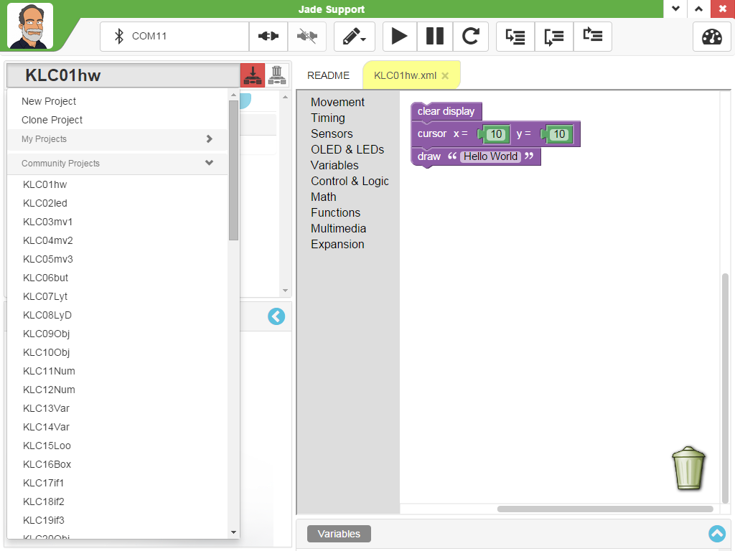
Select “KLC01hw” Project
Selected Project
Scratch Program
Available
“Community
Projects”
Notes:
Can Demo Jade Scratch if people are interested. In doing this product I’ve had a few interesting discoveries – one was going with a simpler programming language actually has a *LOT* of value for an expert like myself.

Slide 20
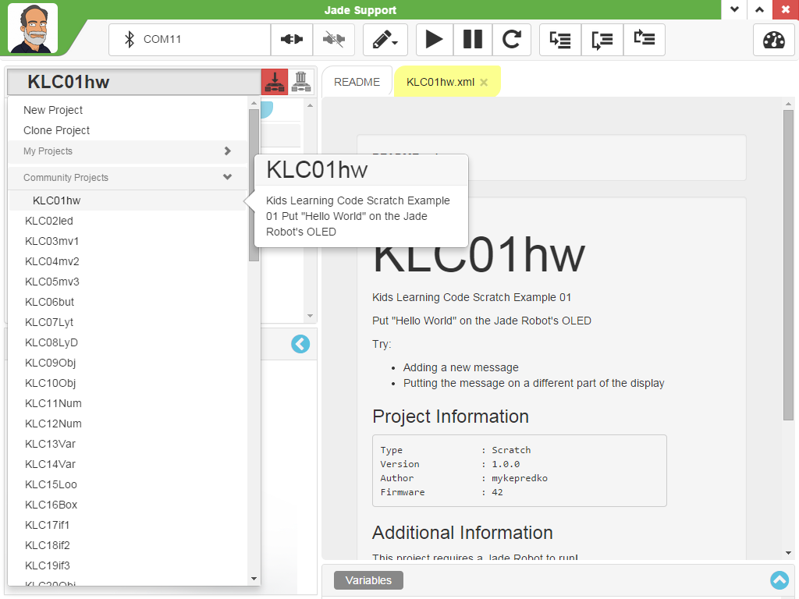
Project “Readme” Information
Project Description
Specified when
Project Created
“Readme” with
Program Info
Notes:
Can Demo Jade Scratch if people are interested. In doing this product I’ve had a few interesting discoveries – one was going with a simpler programming language actually has a *LOT* of value for an expert like myself.

Slide 21
Execute “KLC01hw”
Run Program
Transfer Program
to Jade Robot
Single Step
Program
Pause Program
Run the Program:
“Transfer Program to Jade Robot”
“Run Program”
Single Step Program:
Reset Program
Single Step Program & Watch Display
Reset Program
(Start at beginning)
Notes:
Can Demo Jade Scratch if people are interested. In doing this product I’ve had a few interesting discoveries – one was going with a simpler programming language actually has a *LOT* of value for an expert like myself.

Slide 22
Stop Here
Notes:
Can Demo Jade Scratch if people are interested. In doing this product I’ve had a few interesting discoveries – one was going with a simpler programming language actually has a *LOT* of value for an expert like myself.

Slide 23
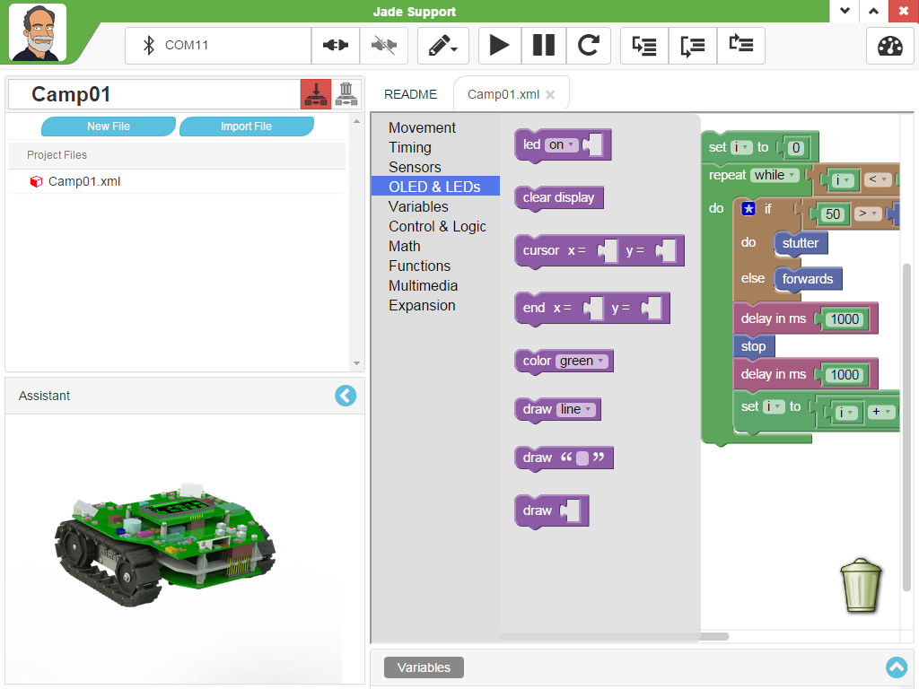
LED & OLED Status Updates Blocks
LED On/Off/Flash – LEDs 0 - 5
Clear OLED Display
Set Position of Next “draw”
“draw” Text String, Cursor Updated
“draw” Integer, Cursor Updated
Notes:
Can Demo Jade Scratch if people are interested. In doing this product I’ve had a few interesting discoveries – one was going with a simpler programming language actually has a *LOT* of value for an expert like myself.

Slide 24
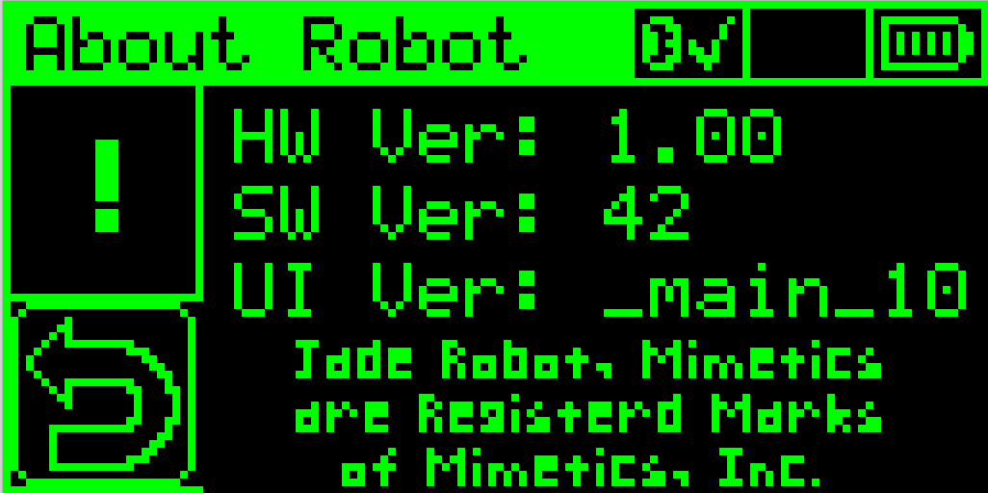
OLED Display
Origin (0,0)
End (127, 63)
Notes:
Can Demo Jade Scratch if people are interested. In doing this product I’ve had a few interesting discoveries – one was going with a simpler programming language actually has a *LOT* of value for an expert like myself.

Slide 25
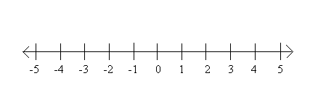
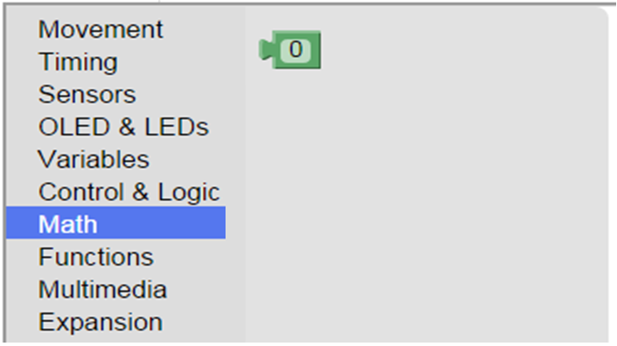
Integer Numbers
To -2.1Billion
To +2.1Billion
Set Integer Value
0 – Logic “False”
Not 0 – Logic “True”
Notes:
Can Demo Jade Scratch if people are interested. In doing this product I’ve had a few interesting discoveries – one was going with a simpler programming language actually has a *LOT* of value for an expert like myself.

Slide 26
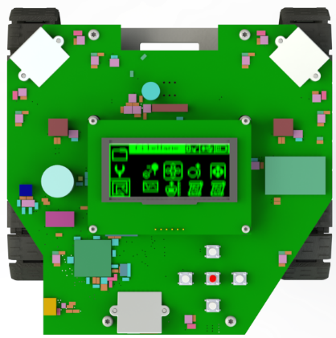
Robot Motion
Tracks Moving in
Same Direction &
Same Speed
Tracks Moving in
Different Direction
Or Different Speed
Notes:
Can Demo Jade Scratch if people are interested. In doing this product I’ve had a few interesting discoveries – one was going with a simpler programming language actually has a *LOT* of value for an expert like myself.

Slide 27
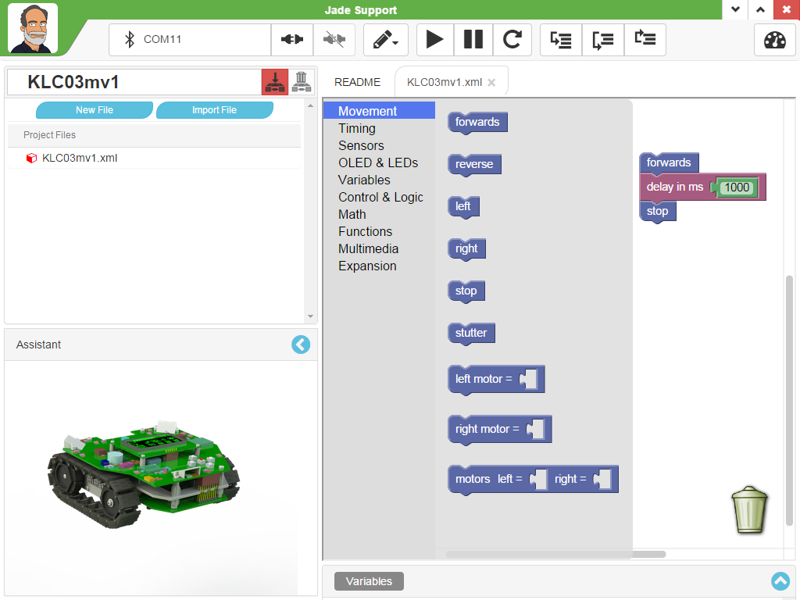
Movement Blocks
Movement Continues Until There is A Change or “Pause”, “Reset”, “Transfer to Robot”
Set Individual Motor Values
-100 – Full Reverse
0 - Stop
100 – Full Forwards
Notes:
Can Demo Jade Scratch if people are interested. In doing this product I’ve had a few interesting discoveries – one was going with a simpler programming language actually has a *LOT* of value for an expert like myself.

Slide 28
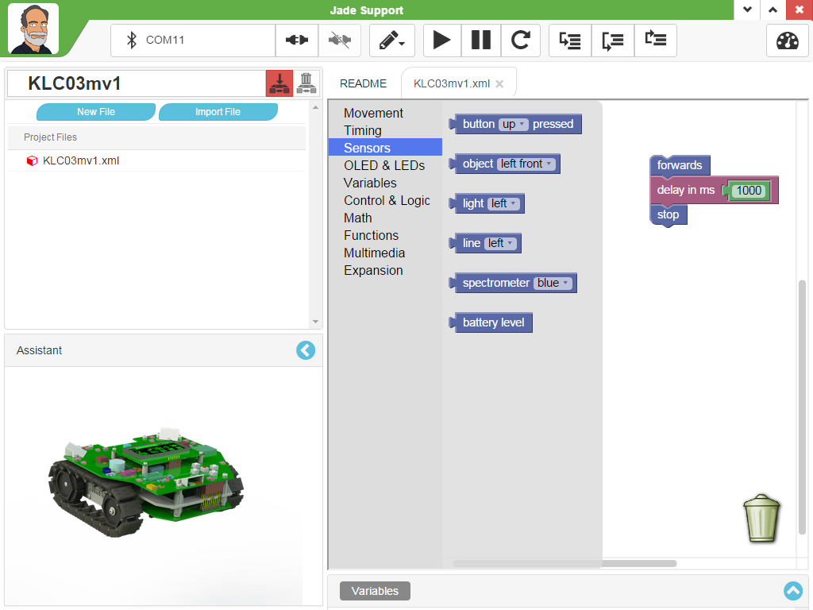

Inputs – Buttons and Sensors
0 – When Not Pressed, -1 – When Pressed
Distance to Object (0 – Close, 100 – Far)
Brightness to Sensor (0 – Dark, 100 – Light)
Front
Left
Right
Side
Side
Rear
Notes:
Can Demo Jade Scratch if people are interested. In doing this product I’ve had a few interesting discoveries – one was going with a simpler programming language actually has a *LOT* of value for an expert like myself.

Slide 29
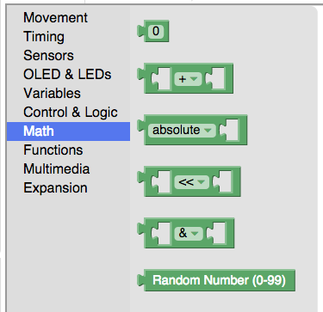
Math Blocks
Set Integer Value (negative and positive)
Mathematical Operations (+, -, x, /, %)
Single Operator Operations (abs, neg)
Bitwise Shifting
Bitwise Logical Operations (AND, OR, XOR)
Random Numbers (0 to 99)
Notes:
Can Demo Jade Scratch if people are interested. In doing this product I’ve had a few interesting discoveries – one was going with a simpler programming language actually has a *LOT* of value for an expert like myself.

Slide 30
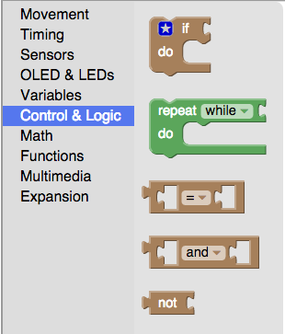
Logic Blocks
“If” with “else” and “else if”
Repeat while/until Condition is True
Comparison Operations (=, !=, <, <=, >, >=)
Logical AND/OR
Logical NOT
Notes:
Can Demo Jade Scratch if people are interested. In doing this product I’ve had a few interesting discoveries – one was going with a simpler programming language actually has a *LOT* of value for an expert like myself.

Slide 31
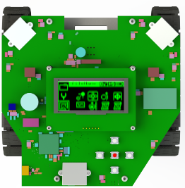
The Challenge – Escape!
4’ Square with 1’ Opening in
Centre of one Side
1’
Square
Box
Challenge:
Start at Position shown
Get all the way out of the 4’ Square
Fastest Robot wins?

Slide 32
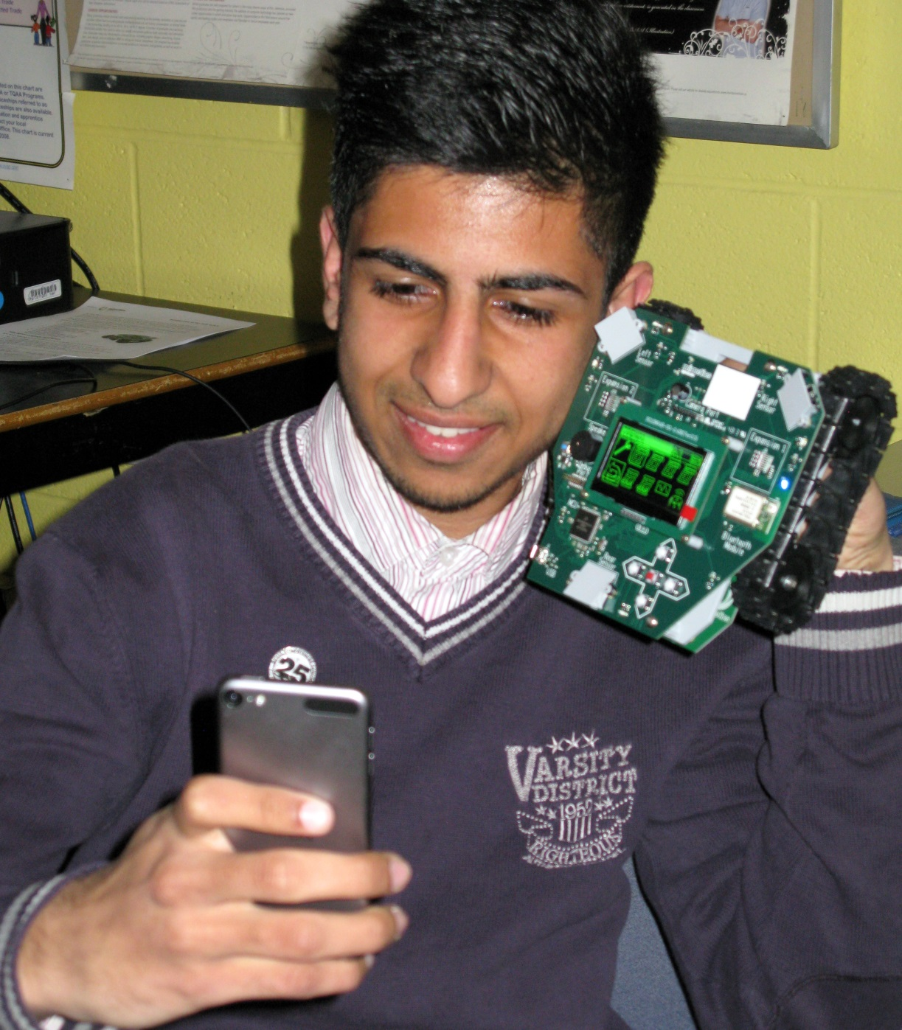
Mimetics and Jade Robot
13 years/15,000 Student Experience
Jade Robot
Next Generation 32Bit Hardware
RTOS with Built in UI, File System
Bluetooth and USB Host Interfaces
Advanced Sensors with Spectrometer
Expandable
Jade Support IDE
Web Based Google App
Cloud Based User Storage
Jade C based Projects with Panel/Sound
Notes:
We want to introduce the Jade Robot and it’s Tools in more detail along with our action plans for it.
It’s interesting, but it’s easy to criticize something when it’s done (especially when you have experience) – a *LOT* more difficult getting it right from the start. Also, preparing this presentation was a great way to review and think about what we should be doing.

Slide 33

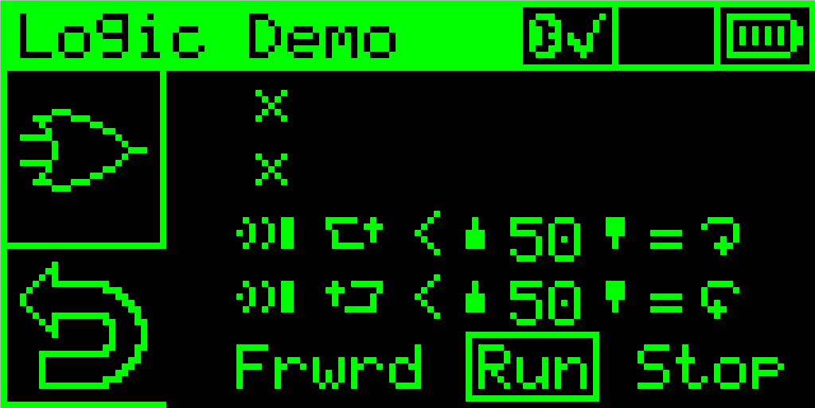
Conditional Execution
100ms
User
Cond
Specified Motion
True
False
User
Cond
Specified Motion
True
False
User
Cond
Specified Motion
Program is like:
“if sensor/Pos’n <|> Value {
specifiedMotion }”
Can Test Object, Light
Different Sensor Positions
Forwards, Back, Turns, Stop and Stutter
True
False
User
Cond
Specified Motion
True
False
Default:
Move Forwards
Notes:
Can Demo Jade Scratch if people are interested. In doing this product I’ve had a few interesting discoveries – one was going with a simpler programming language actually has a *LOT* of value for an expert like myself.

Slide 34
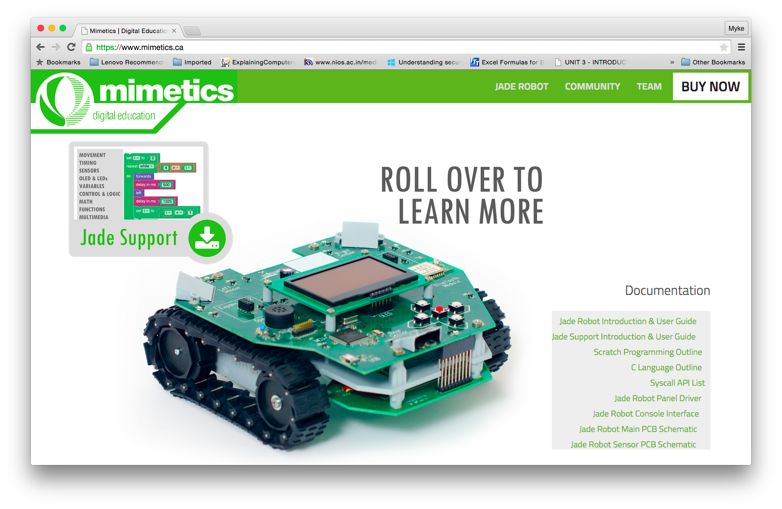
Goto Mimetics Webpage (https://www.mimetics.ca)
Click on
“Jade Support”
All Documentation is Here
Notes:
Can Demo Jade Scratch if people are interested. In doing this product I’ve had a few interesting discoveries – one was going with a simpler programming language actually has a *LOT* of value for an expert like myself.

Slide 35
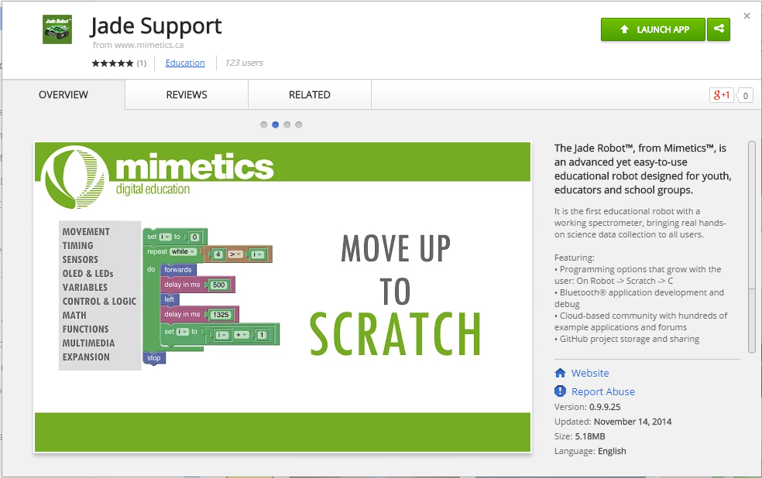
Install Jade Support and Launch It
May say “Free”, “Install” or “Launch”
May get asked to install “Chrome App Launcher”
Provides dialog for starting Jade Support
Notes:
Can Demo Jade Scratch if people are interested. In doing this product I’ve had a few interesting discoveries – one was going with a simpler programming language actually has a *LOT* of value for an expert like myself.

